Slide 1
Offline Reinforcement Learning with LLM
Neel Desai

Slide 2
What Is Offline Reinforcement Learning
In a Traditional Reinforcement Learning an agent learns a task, let us say playing game, by playing the game an number of times, with different actions.
An agent learns to play a game, not by playing it directly, but by analyzing previously gathered gameplay data. This is the essence of offline reinforcement learning (RL).

Slide 3
Major Challenge with Offline RL
Offline RL uses pre-existing datasets, a bit like learning a sport by watching videos instead of playing. The challenge lies in dealing with situations where these datasets are sparse or limited.

Slide 4
How Can LLMs Help Us Overcome it
As the existing LLMs are trained on extremely large datasets, they possess a sophisticated understanding of sequences and predictions.
By fine tunning LLMs we can use their capabilities of understanding sequences and diverse scenarios, to provide inputs and to our an Offline RL Agent

Slide 5
Previous Work
Use of Transformer in Decision-Making . Refining transformer from language processing to decision-making in games, notably through Decision Transformers (DT), where decision-making parallels sequence prediction in language. Decision are treated as a sequence of predictions.
LLMs in Decision-Making: using LMs for separate planning and execution phases, and transforming diverse data types into LM-comprehensible formats.

Slide 6
Proposed Solution: Language Models for Motion Control (LaMo)
LaMo integrates Decision Transformers (DT) with advanced LMs. The fusion of these two models in LaMo aims to bring a nuanced understanding of LMs to the realm of motion control and decision-making in RL. LaMo starts with a well-established LM, GPT-2, which serves as the initial framework for the Decision Transformer. This integration is designed to transfer the rich linguistic and reasoning capabilities of LMs to the domain of decision-making in games and simulations.

Slide 7
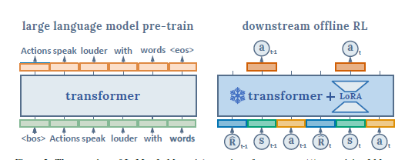

Slide 8
LaMo Uniqueness
Fine-Tuning with LoRA: LaMo employs a fine-tuning technique known as Low Rank Adaptation (LoRA), which adjusts only a small portion of the LM’s parameters. This selective fine-tuning ensures that the model retains its vast linguistic knowledge while adapting to the specific nuances of decision-making tasks.
Non-Linear MLPs for Embeddings: LaMo replaces the standard linear embedding projections of LMs with more complex and capable Multi-Layer Perceptrons (MLPs). This change allows for a more nuanced processing of input data, vital for handling the complexities of RL tasks.

Slide 9
LaMo Uniqueness
3. Auxiliary Language Prediction Loss: To maintain the LM’s proficiency in language understanding and generation, LaMo incorporates an auxiliary language prediction task during training. This additional objective ensures that while the model learns decision-making strategies, it does not lose its inherent language capabilities

Slide 10
Performance
LaMo was tested in various scenarios such as MuJoCo simulations, Atari games, and a virtual Kitchen setup, the result shows that it performed well in these tasks when reward and data was limited. It preformed better than traditional methods like CQL, IQL, TD3+BC, and even the standard Decision Transformer.
In dense-reward tasks, where data is abundant, LaMo’s performance is competitive, although it does not always dominate. This illustrates the still-present strengths of traditional value-based methods in certain offline RL scenarios.

Slide 11
Limitations
Its performance in dense reward task, is not always the best
auxiliary language prediction loss doesn’t universally boost performance across all tasks

Slide 12
Conclusion
LaMo stands out as a pioneering framework that effectively marries the advanced language understanding abilities of LMs with the strategic decision-making required in offline RL. Its prowess in sparse-reward tasks and exceptional performance in low-data scenarios underscore the potential of LMs in enhancing offline RL methodologies.

Slide 13
Thank you

